Slide 1
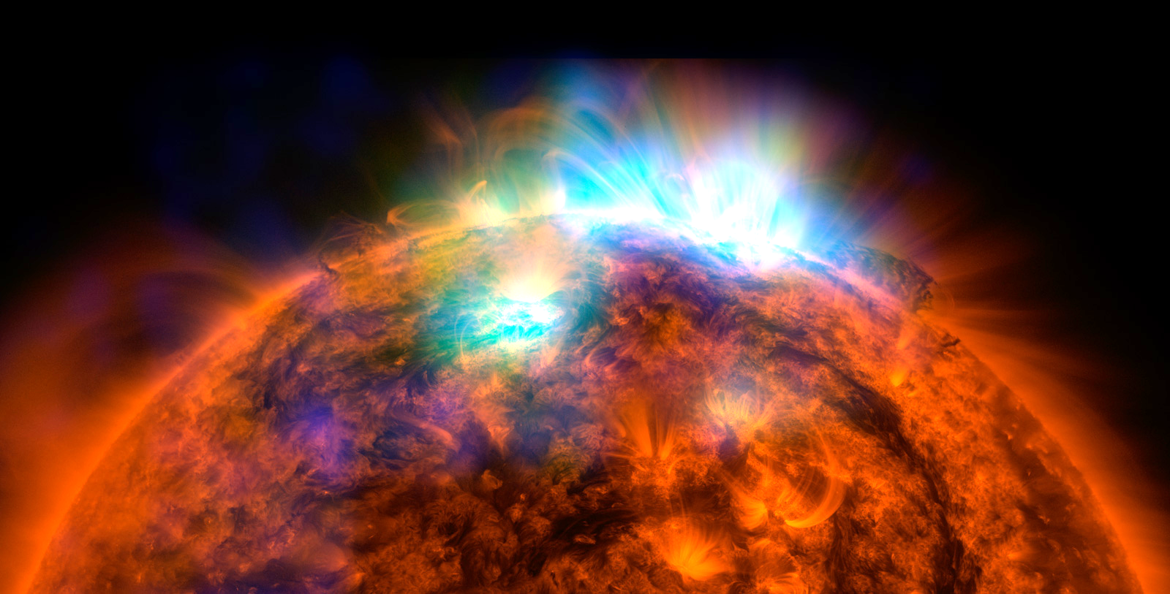
THE SOLAR SYSTEM
We will describe the structure of our solar system

Slide 2
Repeat the opposite word/phrase.
GRAVITY
PULL TOWARDS OBJECT

Slide 3
Repeat the opposite word/phrase.
ORBIT
PATH AROUND AN OBJECT

Slide 4
We will review Year 7 Space topics
TRACK WITH ME
READ WITH ME
We will identify the planets and their order
We will identify the force that causes planetary objects to orbit
We will explain the different phases of the moon
Let’s make some more
DECLARE THE OBJECTIVE
Read the learning objective to your partner.
Notes:
Learning Objectives contain concepts (nouns, big ideas), skills (verbs, measurable behaviours) and sometimes context (restricting or targeting conditions).
●Example: Students will be able to describe the concept of density and apply it to floating and sinking.
●
Success criteria are specific measurable outcomes that if met mean that the student has met the learning objective.
Examples:
•Students will be able to compare densities of substances using mass and volume.
•Students will be able to identify whether a solid or liquid will float or sink in a liquid based on their densities.

Slide 5
DRAW: A diagram to show how we can see the moon when it does not give out it’s own light | LIST: The names of the planets in the correct order. Do you know a good mnemonic? | EXPLAIN: How a solar eclipse occurs and draw a diagram to show this.
WRITE: The length of the following: Day Month Year Leap Year Explain what the length of a year is different on each planet | DESCRIBE: What a satellite is Give an example of a natural satellite Give two examples of artificial satellites | NAME: The force that keeps objects in orbit. Explain how this force differs on planets of different sizes
WRITE: 14 questions that can be answered using these 14 words. Quiz your partner → → → | Day Month Year Season Solar System Lunar Eclipse Solar Eclipse | Star Galaxy Comet Meteor Orbit Satellite Light Year

Slide 6
We will review Year 7 Space topics
TRACK WITH ME
READ WITH ME
We will identify the planets and their order
We will identify the force that causes planetary objects to orbit
We will explain the different phases of the moon
Let’s make some more
DECLARE THE OBJECTIVE
Read the learning objective to your partner.
Notes:
Learning Objectives contain concepts (nouns, big ideas), skills (verbs, measurable behaviours) and sometimes context (restricting or targeting conditions).
●Example: Students will be able to describe the concept of density and apply it to floating and sinking.
●
Success criteria are specific measurable outcomes that if met mean that the student has met the learning objective.
Examples:
•Students will be able to compare densities of substances using mass and volume.
•Students will be able to identify whether a solid or liquid will float or sink in a liquid based on their densities.

